Slide 1
Convolution
23rd november 2020

Slide 2
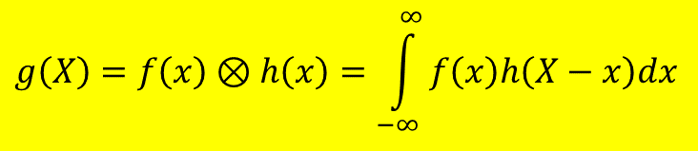
What is the convolution?
Convolution is a mathematical operation on two functions (f and h) that produces a third function (g) expressing how the shape of one is modified by the other.
The term convolution refers to both the resulting function and to the process of computing it.
It is defined as the integral of the product of the two functions after one is reversed and shifted. And the integral is evaluated for all values of shift, producing the convolution function.
$$g\left(X\right)=f\left(x\right)⊗h\left(x\right)=\int_{−∞}^{∞}{f\left(x\right)h\left(X−x\right)dx}$$

Slide 3
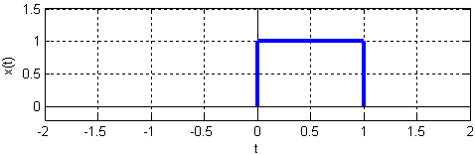
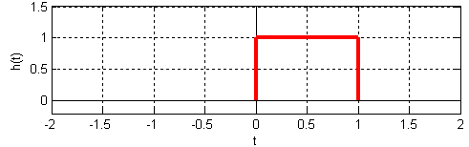
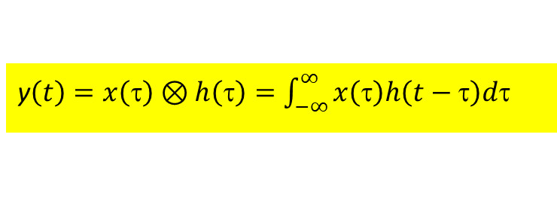
Example 1 : 1-D Convolution of two square pulses
Consider two square pulses in 1-D time domain
Recall the definition of the convolution (variables are changed appropriately)
x(τ)
h(τ)
τ
τ
y$\left(t\right)=x\left(\right)⊗h\left(\right)=\int_{−∞}^{∞}{x\left(\right)h\left(t−\right)d}$
https://cnx.org/contents/-eLl_Dug@19.20:h0BzlV-O@7/Convolution-Complete-example

Slide 4
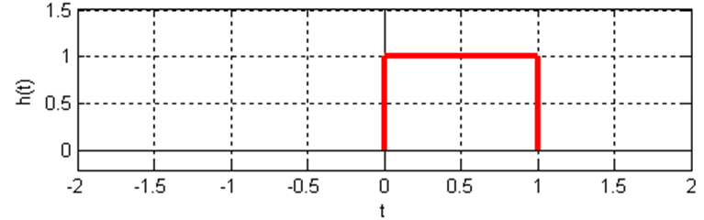
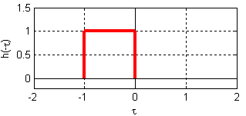

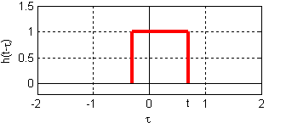
Example 1
For the 1st step, we take one of the functions ;i.e., h(τ), and reflect it around the y-axis by using the method described in the next slide.
The function then becomes h(-τ). In fact, the full form of the function is h(t - τ) and at this initial location t = 0.
Note that before reflection : 0 < τ < 1; after reflection : -1 < τ < 0.
To shift the function h(t - τ) to the right, t has to be appropriately chosen.
h(τ)
Reflected square wave
Reflected and shifted square wave

Slide 5
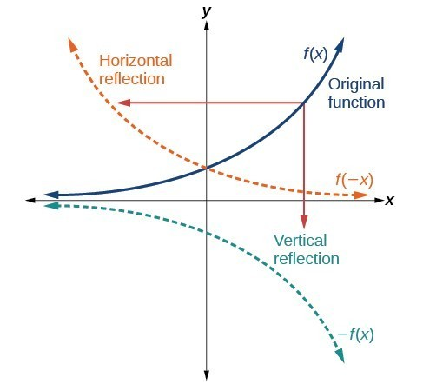
HOW TO: GIVEN A FUNCTION, REFLECT THE GRAPH BOTH VERTICALLY AND HORIZONTALLY.
Example 1
1. Multiply all outputs by –1 for a vertical reflection. The new graph is a reflection of the original graph about the x-axis.
2. Multiply all inputs by –1 for a horizontal reflection. The new graph is a reflection of the original graph about the y-axis.
https://courses.lumenlearning.com/epcc-atdcoursereview-collegealgebra-1-2/chapter/graph-functions-using-reflections-about-the-x-axis-and-the-y-axis/

Slide 6
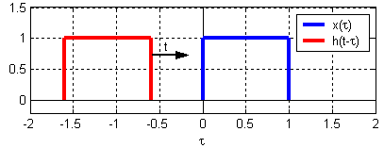
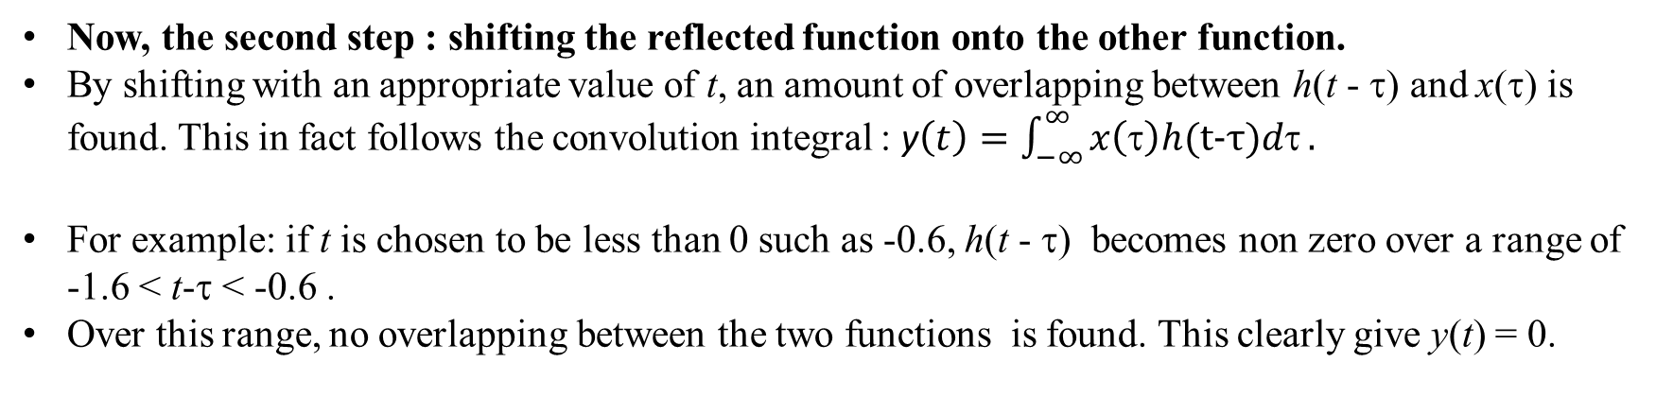
Example 1
Since convolution is commutative ;i.e. x⊗h = h⊗x, it will never be matter which function is reflected and shifted.
However, as the functions become more complicated reflecting and shifting the “right one” will often make the problem much easier.
Now, the second step : shifting the reflected function onto the other function.
By shifting with an appropriate value of t, an amount of overlapping between h(t - τ) and x(τ) is found. This in fact follows the convolution integral : y$\left(t\right)=\int_{−∞}^{∞}{x\left(τ\right)h(t−τ)dτ}.$
For example: if t is chosen to be less than 0 such as -0.6, h(t - τ) becomes non zero over a range of -1.6 < t-τ < -0.6 .
Over this range, no overlapping between the two functions is found. This clearly give y(t) = 0.
https://cnx.org/contents/-eLl_Dug@19.20:h0BzlV-O@7/Convolution-Complete-example

Slide 7
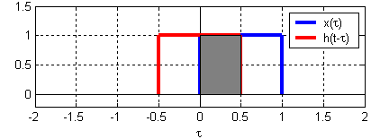
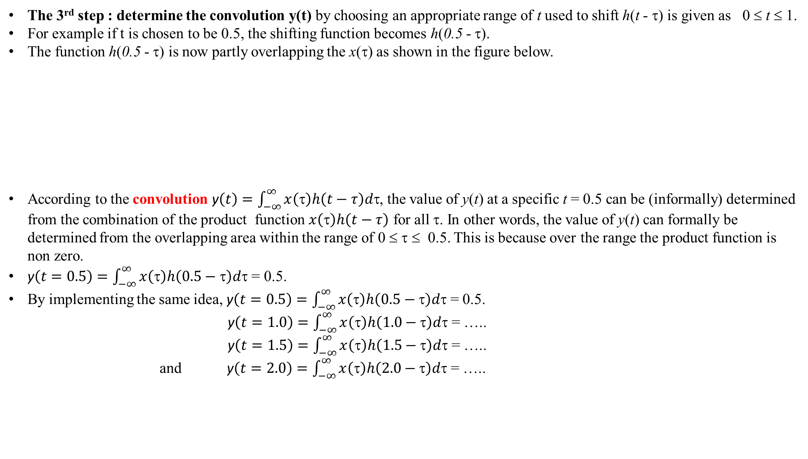
Example 1
The 3rd step : determine the convolution y(t) by choosing an appropriate range of t used to shift h(t - τ) is given as 0 ≤ t ≤ 1.
For example if t is chosen to be 0.5, the shifting function becomes h(0.5 - τ).
The function h(0.5 - τ) is now partly overlapping the x(τ) as shown in the figure below.
According to the convolution y$\left(t\right)=\int_{−∞}^{∞}{x\left(τ\right)h\left(t−τ\right)dτ}$, the value of y(t) at a specific t = 0.5 can be (informally) determined from the combination of the product function $x\left(τ\right)h\left(t−τ\right)$ for all τ. In other words, the value of y(t) can formally be determined from the overlapping area within the range of 0 ≤ τ ≤ 0.5. This is because over the range the product function is non zero.
y$\left(t=0.5\right)=\int_{−∞}^{∞}{x\left(τ\right)h\left(0.5−τ\right)dτ}$ = 0.5.
By implementing the same idea, y$\left(t=0.5\right)=\int_{−∞}^{∞}{x\left(τ\right)h\left(0.5−τ\right)dτ}$ = 0.5.
y$\left(t=1.0\right)=\int_{−∞}^{∞}{x\left(τ\right)h\left(1.0−τ\right)dτ}$ = …..
y$\left(t=1.5\right)=\int_{−∞}^{∞}{x\left(τ\right)h\left(1.5−τ\right)dτ}$ = …..
and y$\left(t=2.0\right)=\int_{−∞}^{∞}{x\left(τ\right)h\left(2.0−τ\right)dτ}$ = …..
1.0
0.5
0.0
Notes:
Although the product x(τ)h(t-τ) = 1 always, dτ is different. For example, $\int_{−∞}^{∞}{x\left(τ\right)h\left(0.5−τ\right)dτ}$ = 0.5, in this case, dτ = 0.5. Therefore y$\left(t=0.5\right)$ = 0.5.

Slide 8
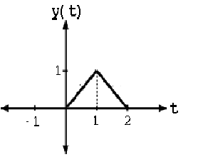
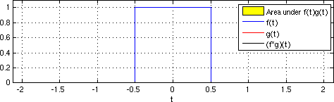
Example 1
From specific steps of t, we can combine them together and the graph of the convolution function y(t) = x⊗h is given as
In conclusion, when convolving two square pulses, the result will always be a triangular pulse.
The width of the resulting convolution will always equal the sum of the overall widths of the two contributing functions.
https://upload.wikimedia.org/wikipedia/commons/6/6e/Convolution_of_box_signal_with_itself.gif

Slide 9

Example 2
Now consider the two asymmetrical spatial function f(x) and h(x).
Determine the 1-D convolution g(X) = $\int_{−∞}^{∞}{f\left(x\right)h\left(X−x\right)dx}$

Slide 10
1st step : reflection
Example 2
h(x) is chosen to sweep across f(x).
To find the reflection of h(x) about y axis, multiply all inputs with -1.
Therefore, h(x) is just flipped around the y axis and becomes h(-x).
Generally, the flipped function can be written as h(X-x).
With an appropriate X, the function may sweep rightward or leftward.
Notes:
Y axis = ordinate

Slide 11
2nd step : shifting
Example 2
The h(x) is flipped or mirrored about the origin, becoming h(-x).
Note that X can be either positive or negative value depending on the shifting direction of the function h(X-x).
Here, X = 0, 1, 2, and 3 and as a result, the rectangular pulse progresses to the right.
The function h(X - x) at X = 0, 1, 2, and 3

Slide 12
3rd step: Determination of g(X)
Example 2
From figs. (b) to (h), g(X) becomes non zero because h(X-x) sweeps over f(x).
g(X) at particular values of X can be found from the integral over the product of the functions f(x) h(X-x).
The area, A, under the product curve is the value of g(X) at that value of X.
Because the magnitude of the function h(X-x) is one, the product f(x) h(X-x) is clearly equal to f(x).

Slide 13
Example 3
Example 3
Consider the functions ƒ(x) and h(x) depicted in the accompanying diagram.
0.5
-0.25
0.25
Can you guess the convolution function g(X).
Graphically convolve those two functions, explaining each step of the process.

Slide 14
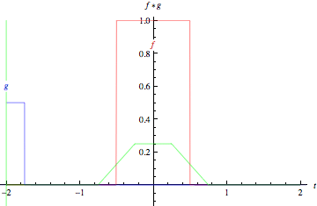
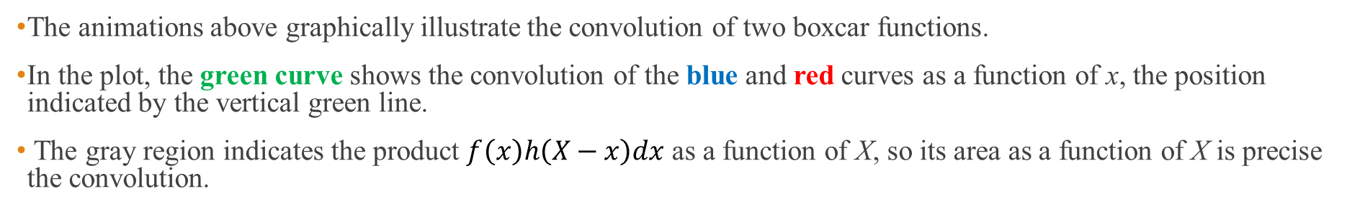
Example 3
The animations above graphically illustrate the convolution of two boxcar functions.
In the plot, the green curve shows the convolution of the blue and red curves as a function of x, the position indicated by the vertical green line.
The gray region indicates the product $f\left(x\right)h\left(X−x\right)dx$ as a function of X, so its area as a function of X is precise the convolution.
https://mathworld.wolfram.com/Convolution.html

Slide 15

Example 3
The symmetric h(x) is chosen to sweep across f(x).
The full form of the flipped h(x) is h(X-x).
As ever, h(X-x) is shifted to a starting point where the functions contact. This can be achieved by choosing X = -0.75 (fig. (a)).
At this specific X, $g\left(X\right)=f\left(x\right)⊗h\left(x\right) =$ 0.
As h(X-x) sweeps across f(x), overlapping between the two functions occur and $g\left(X\right)$can be worked out accordingly.
For example, at X = -0.5 (fig. (b)), $f\left(x\right)h\left(−0.5−x\right)$ over -0.5 ≤ x ≤ -0.25 is found to be 0.125 (= 0.5 × 0.25).
At X = -0.25 (fig. (c)), $f\left(x\right)h\left(−0.25−x\right)$ over -0.5 ≤ x ≤ 0 is found to be 0.25 (= 0.5 × 0.5).
Eventually, the complete convolution is obtained as illustrated in fig. (d).

Slide 16
Example 4 : self convolution = autoconvolution
Sketch the self-convolution of the double slit function shown below
τ
τ
Notes:
Using the fact that the self convolution of square or rectangular is triangular shape.

Slide 17
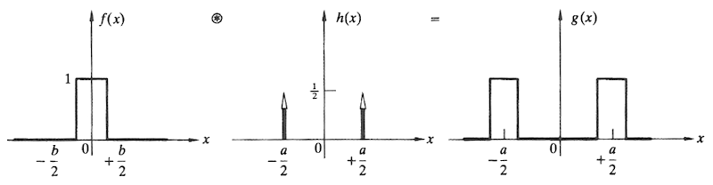
Example 5 Aperture function of a double slit
Regarding the double slit, in practice, each aperture actually has some finite shape.
A method of convolution can be used to create a proper aperture function, e.g., actual double slit.
The aperture function g(x) is obtained by convolving the δ function spike h(x) , that locate each slit, with the rectangular pulse, f(x) that corresponding to the particular opening.
https://www4.uwsp.edu/physastr/kmenning/Phys385/Lect28.html

Slide 18
Convolution theorem
Suppose we have two function f(x) and h(x) with Fourier transform F(f(x)) = F(k) and F(h(x)) = H(k), respectively.
The convolution theorem states that if g = f⊗h
F{g} = F{f⊗g} = F{f} . F{h}
Or G(k) = F(k)H(k)
Where F{g} = G(k).
“The transform of the convolution of two functions is the product of their transforms.”

Slide 19
Example 6 Proof of the convolution theorem
Starting with the convolution between two square.
This gives a triangular pulse.
Now, find the Fourier transform of g (F(g)).
Determine the Fourier transform of each square.
Regarding to the convolution theorem:
F{g} = F{f⊗g} = F{f} . F{h}
This example clearly proves the theorem!
Notes:
You can either find the fourier transform of the convolution by a hard way (i.e. finding the fourier transform direction) or using an elegant way of convolution theorem.

Slide 20

Example 7 Convolution theorem and double slit diffraction
The aperture function can be derived from the convolution between a rectangular pulse and two symmetric delta functions.

Slide 21
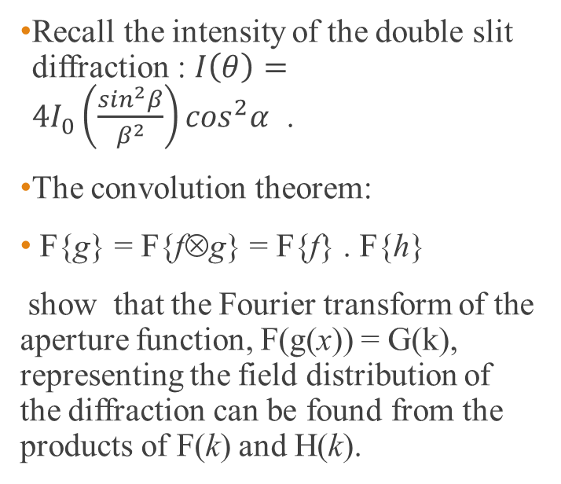

Solution
Example 7
Recall the intensity of the double slit diffraction : $I\left(θ\right)=4I_{0}\left(\frac{\sin^{2}β}{β^{2}}\right)\cos^{2}α$ .
The convolution theorem:
F{g} = F{f⊗g} = F{f} . F{h}
show that the Fourier transform of the aperture function, F(g(x)) = G(k), representing the field distribution of the diffraction can be found from the products of F(k) and H(k).
$$\operatorname{sinc}{\frac{kb}{2}}$$

Slide 22
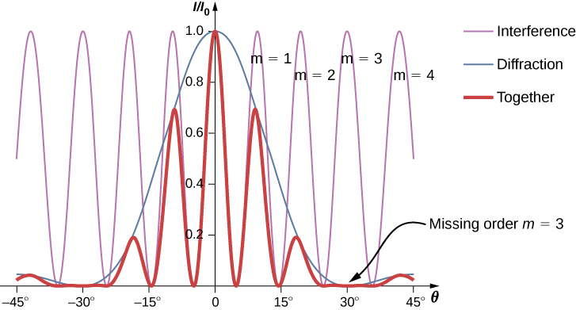


Intensity from double slit diffraction
: $I\left(θ\right)=4I_{0}\left(\frac{\sin^{2}β}{β^{2}}\right)\cos^{2}α$
$α$=$\frac{ka}{2},β=\frac{kb}{2}$
a = slit space
b = slit width
https://openstax.org/books/university-physics-volume-3/pages/4-3-double-slit-diffraction

Slide 23
Example 8
Sketch the convolution of the two functions in the figure below.
Find the Fourier transform of the convolution by using the convolution theorem.
f(x)
h(x)

Slide 24
Solution
Example 8

Slide 25
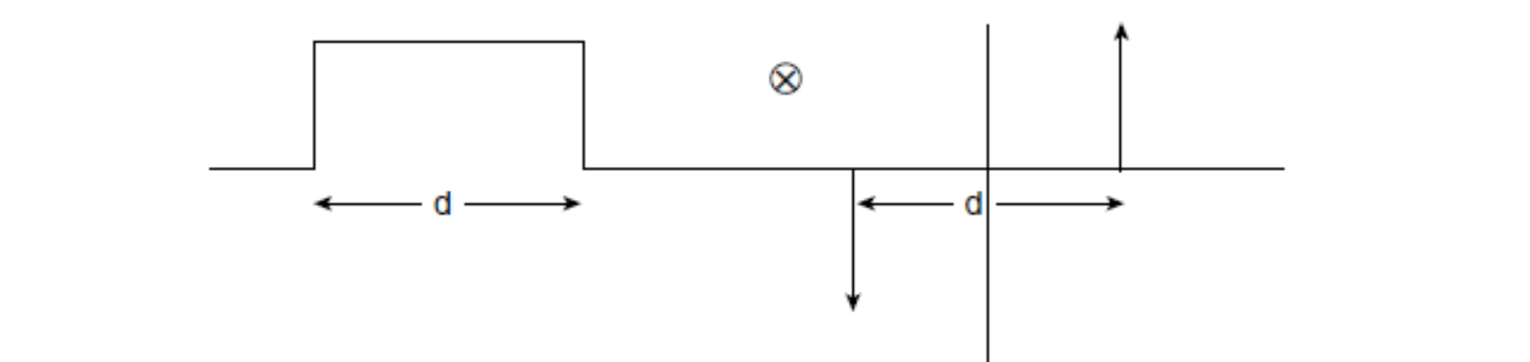
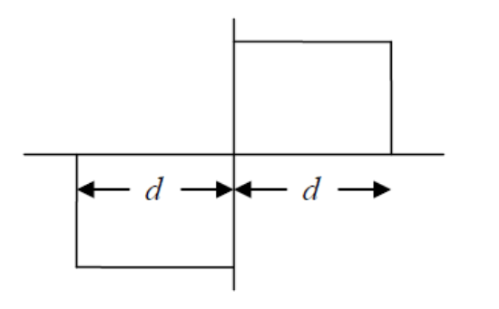
Detail of solution
We have to follow three steps of operation : finding reflection, shifting and determine the convolution.
Subsequently, this part is originated as the upward arrow passing through f(x).
This part is originated when the downward arrow passing through f(x).
h(X-x)
f(x)
g(X)

Slide 26
Solution (cont.)
Example 8
The Fourier transform of the convolution can be found by applying the convolution theorem.
This means that the Fourier transform of the rectangular pulse and two asymmetric delta functions have to be determined.
Then the product of the Fourier transform is the Fourier transform of the convolution according to the convolution theorem.
The procedure mentioned can be roughly illustrated by the figure on the left.

Slide 27
Example 9 Autoconvolution of a uniformly illuminated circular hole
y
x
The circular, uniformly illuminated hole in an opaque screen has to be described by an aperture function f(x,y).
Therefore, to find the autoconvolution, we just have to sweep one circle over the other and record the product area at each displacement.
The irradiance of the convolution can be described by this graph.
Uniformly illuminated circular hole
autoconvolution

Slide 28
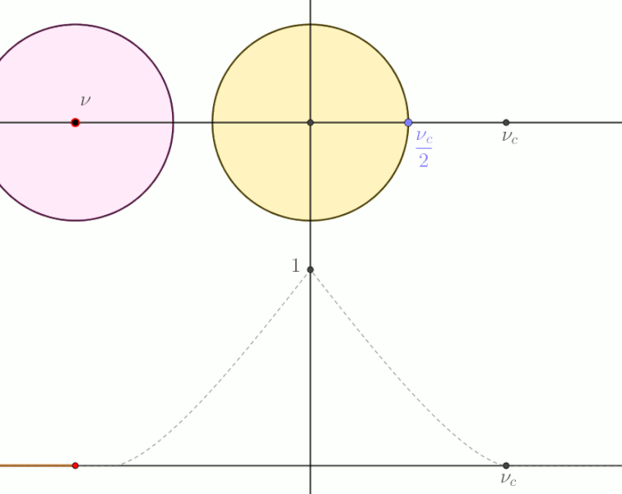
The auto convolution of uniformly illuminated circular hole
https://commons.wikimedia.org/wiki/File:Autoconvolution_disk.gif

Slide 29
Example 10 2-D Autoconvolution
The figure given here is the two-dimensional signal.
Find the autoconvolution of the signal by using a graphical method.
Recall 3 steps to find the convolution
1. Reflection : in this case, the reflection must be done about
vertical and horizontal axes due to 2-D operation,
2. Shifting horizontally and vertically, and
3. Record the product at each displacement.

Slide 30
From this point on the procedure for finding 2-D convolution by a graphical method will be described.

Slide 31
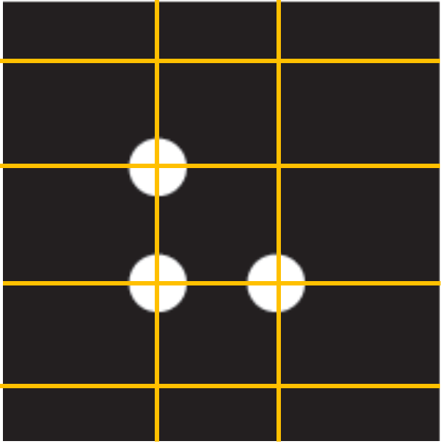
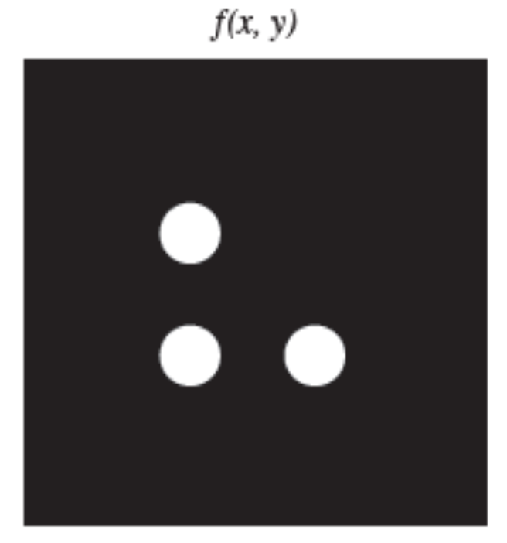
y
First of all let’s define what we need to perform the 2-D convolution graphically.
Since what we are going to do is the autoconvolution, the starting functions are
identical. One function composed of three uniformly illuminated circular dots
arranged in L shape is designated as f(x,y) while the other identical function is
assigned as h(x,y). The convolution g(X,Y) is prepared on the right.
x
g(X,Y)
2-D autoconvolution
f(x,y)
h(x,y)
Grid is introduced to make the shifting easy to follow.
Notes:
Choose Format (main bar)
Flip h(x,y) about y (flip horizontal) and about x (flip vertical) to achieve h(-x, -y), the full form is h(X-x,Y-y)
The L will end up facing left as if it had been rotated through 180 about one of the circular aperture.

Slide 32
y
(2) Find the reflection of h(x,y) twice. One is the reflection about y axis (= horizontal flip) and the other is the reflection about x axis (vertical flip). By doing the horizontal flip h(x,y) becomes h(-x, y). Likewise, by doing the vertical flip h(-x,y) becomes h(-x,-y). Generally, this reflected function can be written as h(X-x, Y-y). The function h(X-x, Y-y) represented by L faces to the left. This is equivalent to rotate the f(x,y) by 180⁰ around the dot at the origin.
x
g(X,Y)
2-D autoconvolution
f(x,y)
h(x,y) → h(X-x, Y-y)
This dot is assumed to locate at the origin.
Notes:
Choose Format (main bar)
Flip h(x,y) about y (flip horizontal) and about x (flip vertical) to achieve h(-x, -y), the full form is h(X-x,Y-y)
The L will end up facing left as if it had been rotated through 180 about one of the circular aperture.

Slide 33
(3) Now, we are going to execute the shifting procedure. The h(X-x, Y-y) will be swept over the f(x,y) in directions x and y. We can start from choosing Y and shift X and then moves up for another Y and shift X and so on or vice versa. In this case Y is firstly selected and X is shifted. As can be seen from this arrangement, at a fixed Y, no overlapping from the X shifting. Therefore, at this specific g(X,Y) = 0.
y
x
X shifting direction shows no overlapping between dots.
g(X,Y)
2-D autoconvolution
Notes:
Choose Format (main bar)
Flip h(x,y) about y (flip horizontal) and about x (flip vertical) to achieve h(-x, -y), the full form is h(X-x,Y-y)
The L will end up facing left as if it had been rotated through 180 about one of the circular aperture.

Slide 34
(4) The shifting process is repeated. Now move the h(X-x, Y-y) up in the +y direction by one interval and then shift the function rightward. This step is equivalent to choose a Y (fixed Y) and then step X. One step is equal one interval. This is clear that by shifting to the right side, three overlapping occur. The first overlap is composed of one pair of dots, the second overlap is composed of two pairs of dots and the last overlap is composed of one pair of dots. At the first overlap located at specific coordinate (X,Y), the convolution g(X,Y) becomes non zero and is assigned as a pale circular dot due to one pair of overlapping dots. At the second overlap located at the next specific coordinate (X,Y), the convolution g(X,Y) again becomes non zero and is assigned as a dark circular dot due to 2 pairs of overlapping dots and the third overlap located at the next specific coordinate (X,Y), the convolution g(X,Y) again becomes non zero and is assigned as a pale circular dot due to 1 pair of overlapping dots.
y
Y shifting direction.
x
X shifting direction shows triple overlapping between dots.
g(X,Y)
2-D autoconvolution
Notes:
Choose Format (main bar)
Flip h(x,y) about y (flip horizontal) and about x (flip vertical) to achieve h(-x, -y), the full form is h(X-x,Y-y)
The L will end up facing left as if it had been rotated through 180 about one of the circular aperture.

Slide 35
(5) The shifting process is repeated. Now move the h(X-x, Y-y) up in the +y direction by one interval and then shift the function rightward. This step is equivalent to choose a Y (fixed Y) and then step X. One step is equal one interval. This is clear that by shifting to the right side, two overlapping occur. The first overlap is composed of two pair of dots and the second overlap is composed of two pairs of dots. At the first overlap located at specific coordinate (X,Y), the convolution g(X,Y) becomes non zero and is assigned as a dark circular dot due to two pair of overlapping dots. At the second overlap located at the next specific coordinate (X,Y), the convolution g(X,Y) again becomes non zero and is assigned as a dark circular dot due to 2 pairs of overlapping dots. And no more overlap occurs as the rightward shifting is made.
y
Y shifting direction.
x
X shifting direction shows twice overlapping between dots.
g(X,Y)
2-D autoconvolution
Notes:
Choose Format (main bar)
Flip h(x,y) about y (flip horizontal) and about x (flip vertical) to achieve h(-x, -y), the full form is h(X-x,Y-y)
The L will end up facing left as if it had been rotated through 180 about one of the circular aperture.

Slide 36
y
x
Y shifting direction.
(6) The shifting process is repeated. Now move the h(X-x, Y-y) up in the +y direction by one interval and then shift the function rightward. This step is equivalent to choose a Y (fixed Y) and then step X. One step is equal one interval. This is clear that by shifting to the right side, only one overlapping occurs. The overlap is composed of one pair of dots. The overlap located at specific coordinate (X,Y), the convolution g(X,Y) becomes non zero and is assigned as a dark circular dot due to two pair of overlapping dots. And no more overlap occurs as the rightward shifting is made.
X shifting direction shows a single overlapping between dots.
g(X,Y)
2-D autoconvolution
Notes:
Choose Format (main bar)
Flip h(x,y) about y (flip horizontal) and about x (flip vertical) to achieve h(-x, -y), the full form is h(X-x,Y-y)
The L will end up facing left as if it had been rotated through 180 about one of the circular aperture.

Slide 37
y
f(x,y)
h(x,y) → h(X-x,Y-y)
x
Description of all procedures mentioned here can be found in the “OPTICS” 5th ed by Hecht p. 564.
This is a complete 2-D autoconvolution.
Notes:
Choose Format (main bar)
Flip h(x,y) about y (flip horizontal) and about x (flip vertical) to achieve h(-x, -y), the full form is h(X-x,Y-y)
The L will end up facing left as if it had been rotated through 180 about one of the circular aperture.

Slide 38
Homework#13

Slide 39
Final exam

Slide 40
